Slide 1
Introduction to C
Abu Saleh Musa Miah(Abid)
Research Student, Centre for Research & Innovation (CRI Unit-1)
Signal Processing & Computational Neuroscience Laboratory.
Dept. of Computer Science and Engineering (CSE).
Universtiy of Rajshahi.

Slide 2
Computer program
To process of particular set of data the computer must be given an appropriate set of instructions called a program . these instruction are entered into the computer and then stored in a portion of computers memory.
Computer Program is a set of instruction that performed some specific task.
CS 3090: Safety Critical Programming in C

Slide 3
Programming language:
A programming language is a special language programmers use to develop software programs, scripts, or other sets of instructions for computers to execute. The following is an index of the different programming and scripting languages currently listed at mine.
Language types
1.From
❖ Machine and assembly languages
❖ Algorithmic languages
• FORTRAN
• ALGOL
• LISP
• C
❖ Business-oriented languages
• COBOL
2. Above the level
 High level - Ada , Modula-2 , Pascal, COBOL, FORTRAN, BASIC, Java, C++.
 Middle level - C, FORTH, Macro-assemble.
 Low level - Assembler.
CS 3090: Safety Critical Programming in C

Slide 4
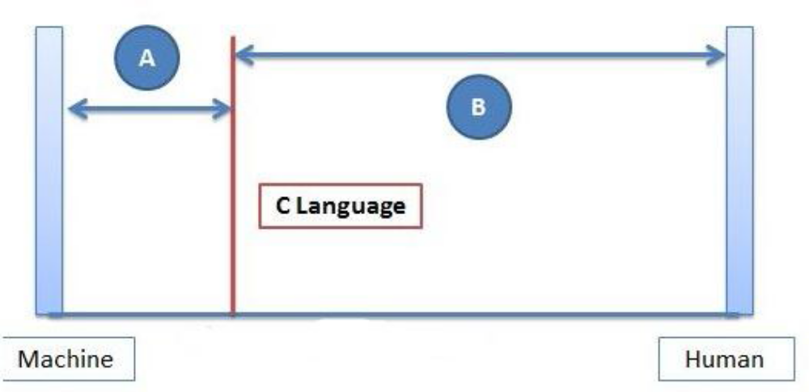
Middle Level Language:
C Programming bridges gap between Machine Understandable Machine Level
language and more conventional High level languages.
Why C is Middle Level Language:
1. C programming language support the low level language i.e. Assembly Language..
2. C language also gives the facility to access memory through pointer.
3. Its combines the elements of high-level languages with the functionalism of assembly language.
4. Using inline assembly language feature in C we can directly access system registers.
5. C Programming also Supports high Level Language Features.
So, C language neither a High Level nor a Low level language but a Middle Level Language.
CS 3090: Safety Critical Programming in C

Slide 5
Compiler
A compiler is a computer program that transforms source code written in a programming language (the source language) into another computer language (the target language)
or
with the latter often having a binary form known as object code.
Why compiler Need?
The term compiler refers to the way in which a program is executed. in theory any programming language can be compiled or interpreted.For example BASIC is usually interpreted and c is usually compiled.
The way a program is executed is not defined by the language in which it is written compilers are simply sophisticated programs that operate on our program source code.
CS 3090: Safety Critical Programming in C

Slide 6
Why to use C?
C was initially used for system development work, in particular the programs that make up the operating
system. C was adopted as a system development language because it produces code that runs nearly as fast
as code written in assembly language. Some examples of the use of C might be:
 Operating Systems
 Language Compilers
 Assemblers
 Text Editors
What is Algorithm
An algorithm (pronounced AL-go-rith-um) is a procedure or formula for solving a problem.
Or An algorithm is a sequence of unambiguous instructions for solving a problem, i.e., for obtaining a required output for any legitimate input in a finite amount of time
Example: If we want largest number from 2 number .that time our algorithm is
      ➢ Input 2 number
      ➢ Choose largest number
      ➢ Then print largest number

Slide 7
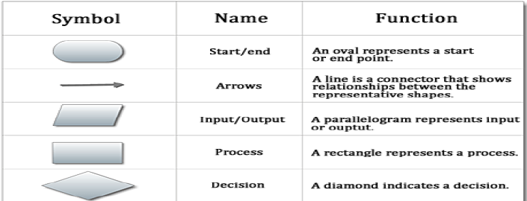
Flowchart
A flowchart is a type of diagram that represents an algorithm, workflow or process, showing the steps as boxes of various kinds, and their order by connecting them with arrows.
or
Flowchart is a graphical representation use to solve a particular problem.
CS 3090: Safety Critical Programming in C

Slide 8
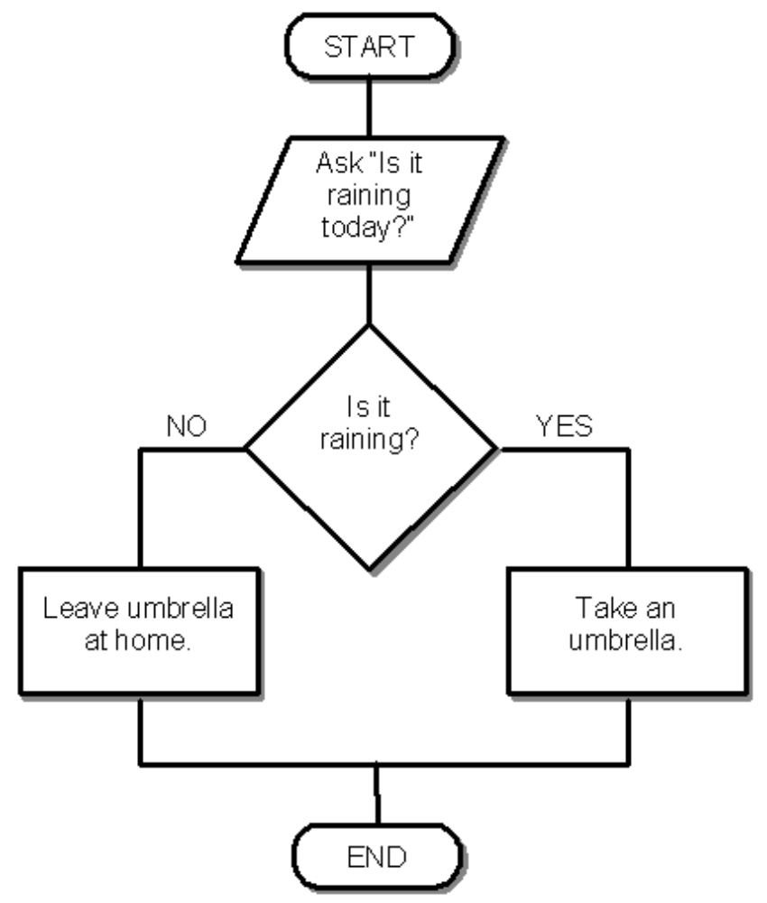
Flowchart

Slide 9
Compiler vs Interpreter
Compiler | Interpreter
Scans the entire program and translates it as a whole into machine code | Translates program one statement at a time.
Intermediate Object Code is Generated | No Intermediate Object Code is Generated
Conditional Control Statements are Executes faster | Conditional Control Statements are Executes slower
Memory Requirement : More (Since Object Code is Generated) | Memory Requirement is Less
Program need not be compiled every time | Every time higher level program is converted into lower level program
6Errors are displayed after entire program is checked | Every Errors are displayed for every instruction interpreted (if any)
7Example : C ,C++Compiler | Example : BASIC, Python, Ruby
CS 3090: Safety Critical Programming in C

Slide 10
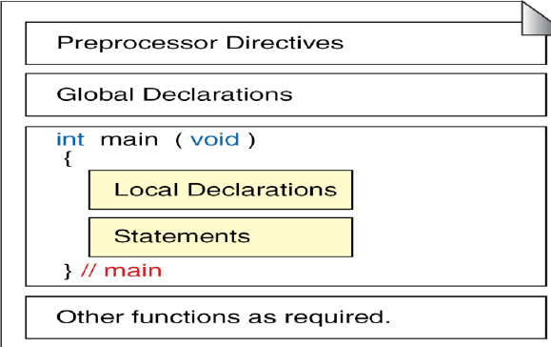
Structured Programming:
Structured programming is a programming paradigm aimed at improving the clarity, quality, and development time of a computer program by making extensive use of subroutines, block structures, for and while loops—in contrast to using simple tests and jumps such as the goto statement which could lead to "spaghetti code" .
CS 3090: Safety Critical Programming in C

Slide 11
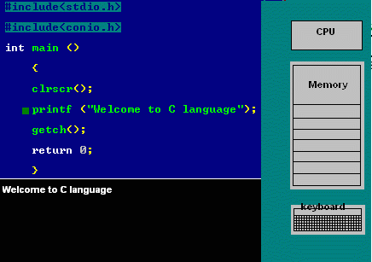
Simple C Program
#include<stdio.h>
int main ()
{
printf
(“Welcome to C language”);
return 0;
}
CS 3090: Safety Critical Programming in C

Slide 12
Different the structured and non structured language
Structured Language | Non structured language
Code compartmentalization can be done | Code compartmentalization cannot be done
Loops can be created | Loops cannot be created
These are new languages | These are old languages
Do not require a strict field concept. | Strict field concept is used mostly.
Examples: C, C++, JAVA, ADA, PASCAL, MODULA -2 | Examples: BASIC, COBOL, FORTRAN
CS 3090: Safety Critical Programming in C

Slide 13
Keyoword
Keywords are the reserved words used in programming. Each keywords has fixed meaning and that cannot be changed by user.
For example:
int money;
Here, int is a keyword that indicates, 'money' is of type integer. As, C programming is case sensitive, all keywords must be written in lowercase
auto double int struct break else long switch case enum register typedef char extern return union const float short unsigned continue for signed void default goto sizeof volatile do if static while
CS 3090: Safety Critical Programming in C

Slide 14
Identif ier
Identifiers allow us to name data and other objects in the program. Each identified object in the
computer is stored at a unique address.
For example:
int money;
Here, int is a keyword that indicates, 'money' is of type integer. As, C programming is case sensitive, all keywords must be written in lowercase
CS 3090: Safety Critical Programming in C

Slide 15
RULES FORIDENTIFIERS/variables
(a) First character must be an alphabet.
(b) Must consist of only letters, digits or underscore.
(c) Only first 31 characters are significant.
(d) Cannot use keyword. Must not contain white space.
(e) C does not allow punctuation characters such as @, $, and % within identifiers.
(f) C is a case sensitive programming language.
CS 3090: Safety Critical Programming in C

Slide 16
Constant Comments
A constant comment is a note that we put into our source code. All comments are ignored by the
compiler. Comments are used primarily to document the meaning
1.single line comment start with
//this is comment line
2.Multiple line comment
They start with /* and terminates with the
Characters and end with */ as shown below:
CS 3090: Safety Critical Programming in C

Slide 17
Variable
Def inition:- Variables are named memory locations that have a type, such as integer or character, which is inherited from their type.
int num;
Here, num is a variable of integer type.
Local Variables
Global Variables
Local Variables: Variables that are declared inside a function or block are local variables.only accessible in a particular region
Global Variables:Global variables are defined outside of all the functions, usually on top of the program.A global variable can be accessed by any function or anywhere
CS 3090: Safety Critical Programming in C

Slide 18
Separate compilation
A C program consists of source code in one or more files
Each source file is run through the preprocessor and compiler, resulting in a file containing object code
Object files are tied together by the linker to form a single executable program
Source code
file1.c
Preprocessor/
Compiler
Object code
file1.o
Libraries
Linker
Executable code
a.out
CS 3090: Safety Critical Programming in C

Slide 19
The preprocessor
The preprocessor takes your source code and – following certain directives that you give it – tweaks it in various ways before compilation.
A directive is given as a line of source code starting with the # symbol
The preprocessor works in a very crude, “word-processor” way, simply cutting and pasting –
it doesn’t really know anything about C!
Your
source
code
Enhanced and
obfuscated
source code
Object
code
Preprocessor
Compiler
CS 3090: Safety Critical Programming in C

Slide 20
Preprocessor directives
#include <stdio.h>
#include <stdlib.h>
#include <string.h>
The #include directives “paste” the contents of the files stdio.h, stdlib.h and string.h into your source code, at the very place where the directives appear.
These files contain information about some library functions used in the program:
  stdio stands for “standard I/O”, stdlib stands for “standard library”, and string.h includes useful string manipulation functions.
Want to see the files? Look in /usr/include
CS 3090: Safety Critical Programming in C

Slide 21
Function prototypes
Q: Why are these needed, if the functions are defined later in the program anyway?
A: C programs are typically arranged in “top-down” order, so functions are used (called) before they’re defined.
  (Note that the function main() includes a call to read_column_numbers().)
  When the compiler sees a call to read_column_numbers() , it must check whether the call is valid (the right number and types of parameters, and the right return type).
  But it hasn’t seen the definition of read_column_numbers() yet!
The prototype gives the compiler advance information about the function that’s being called.
  Of course, the prototype and the later function definition must match in terms of type information.
CS 3090: Safety Critical Programming in C

Slide 22
The main() function
main() is always the first function called in a program execution.
int
main( void )
{ …
void indicates that the function takes no arguments
int indicates that the function returns an integer value
  Q: Integer value? Isn’t the program just printing out some stuff and then exiting? What’s there to return?
  A: Through returning particular values, the program can indicate whether it terminated “nicely” or badly; the operating system can react accordingly.
CS 3090: Safety Critical Programming in C

Slide 23
The printf() function
printf( "Original input : %s\n", input );
printf() is a library function declared in <stdio.h>
Syntax: printf( FormatString, Expr, Expr...)
  FormatString: String of text to print
  Exprs: Values to print
  FormatString has placeholders to show where to put the values (note: #placeholders should match #Exprs)
  Placeholders: %s (print as string), %c (print as char),
  %d (print as integer),
  %f (print as floating-point)
  \n indicates a newline character
Make sure you pick
the right one!
Text line printed only
when \n encountered
Don’t forget \n when
printing “final results”
CS 3090: Safety Critical Programming in C

Slide 24
Return vs. Exit
Let’s look at the return statement in main():
return EXIT_SUCCESS;
EXIT_SUCCESS is a constant defined in stdlib ; returning this value signifies successful termination.
Contrast this with the exit statement in the function read_column_numbers():
CS 3090: Safety Critical Programming in C

Slide 25
Return vs. Exit
Let’s look at the return statement in main():
return EXIT_SUCCESS;
EXIT_SUCCESS is a constant defined in stdlib ; returning this value signifies successful termination.
Contrast this with the exit statement in the function read_column_numbers():
CS 3090: Safety Critical Programming in C

